Slide 1
eROSITA Project Update
12/11/2023

Slide 2
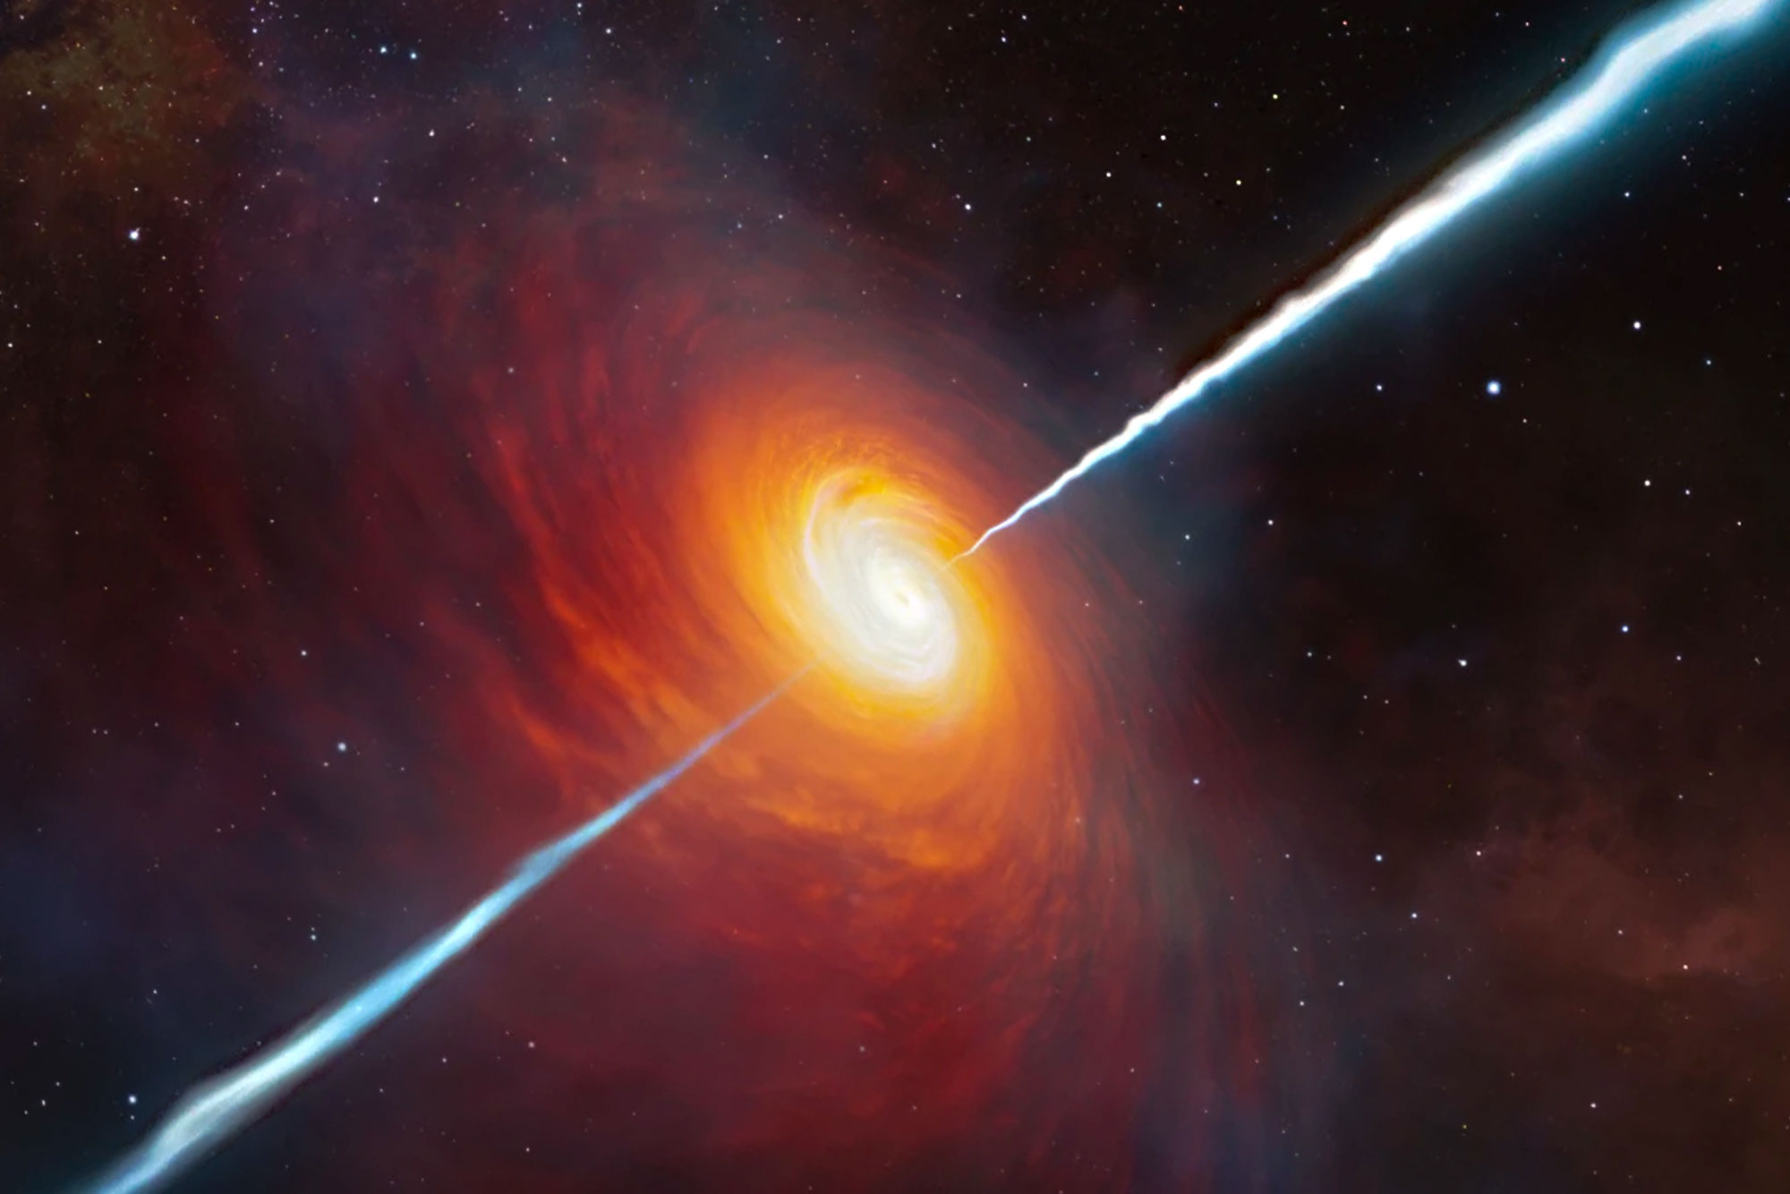
Aim of this project
Short term:
Create an updated list of BL Lac objects that are candidates for TeV observations using data from the ROSAT bright source catalog and the WISE all-sky survey
Expand upon this list using data from the first eROSITA data released (eRASS1)
Perform multi-wavelength analysis of these candidate sources to select the most optimal candidates
Long term:
Use the knowledge from this list of TeV-emitting BL Lac objects to study the relativistic jet of BL Lac objects & understand how it is such an efficient particle accelerator
Make further conjectures about the origin of relativistic jets

Slide 3
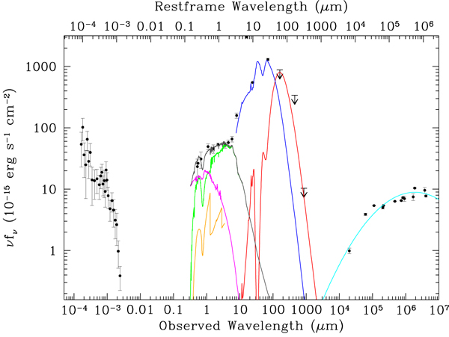
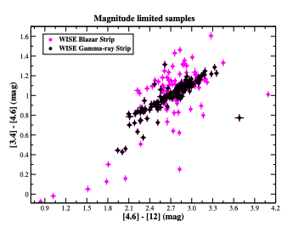
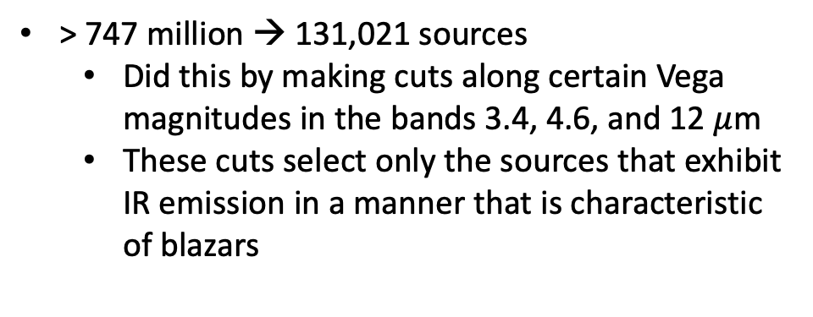
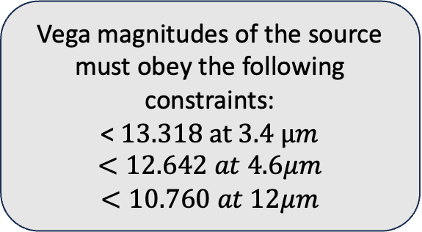
Cutting down the WISE Catalog
> 747 million → 131,021 sources
Did this by making cuts along certain Vega magnitudes in the bands 3.4, 4.6, and 12 $μ$m
These cuts select only the sources that exhibit IR emission in a manner that is characteristic of blazars
3
2
1
Vega magnitudes of the source must obey the following constraints:
< $13.318 at 3.4 μm$
$$<12.642 at 4.6μm$$
$$<10.760 at 12μm$$
Fosbury et al. 2007
Slope of IR emission must follow:
0.22 mag [3.4]-[4.6] < 0.86 mag
1.60 mag < [4.6]-[12] <2.32 mag
Massaro et al. 2012

Slide 4
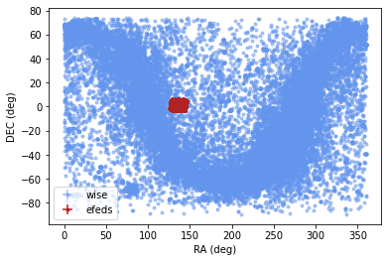
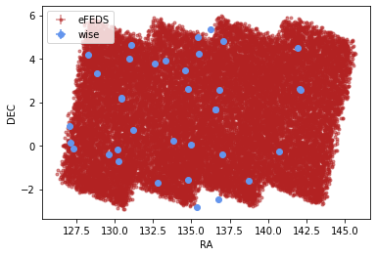
eFEDS & WISE
Using reduced WISE catalog, I was able to match sources between the two catalogs to obtain IR data for sources within the eFEDS region
Look for matches between the two catalogs that fall within the positional error supplied in the eFEDS catalog
Unfortunately, the eFEDS catalog is only ~140 sq. degrees and so no matches between the two catalogs were found

Slide 5
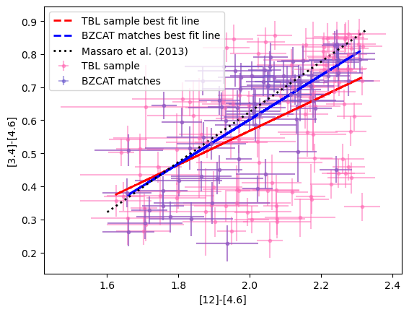
ROSAT & WISE
I received 180 matches between the WISE catalog and ROSAT catalog (to be a match the separation between the two sources must be less than the ROSAT positional error)
Massaro et al. (2013) received 189 matches
Of these 180 sources, 73 of them were listed in the ROMA-BZCAT catalog
Of Massaro et al.’s sources, 93 of them were listed in the ROMA-BZCAT catalog

Slide 6
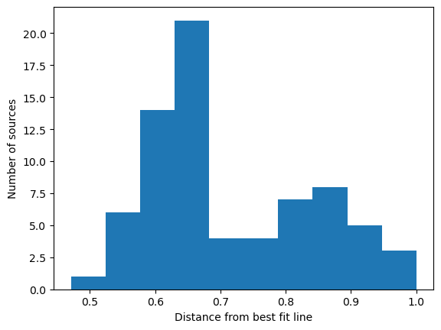
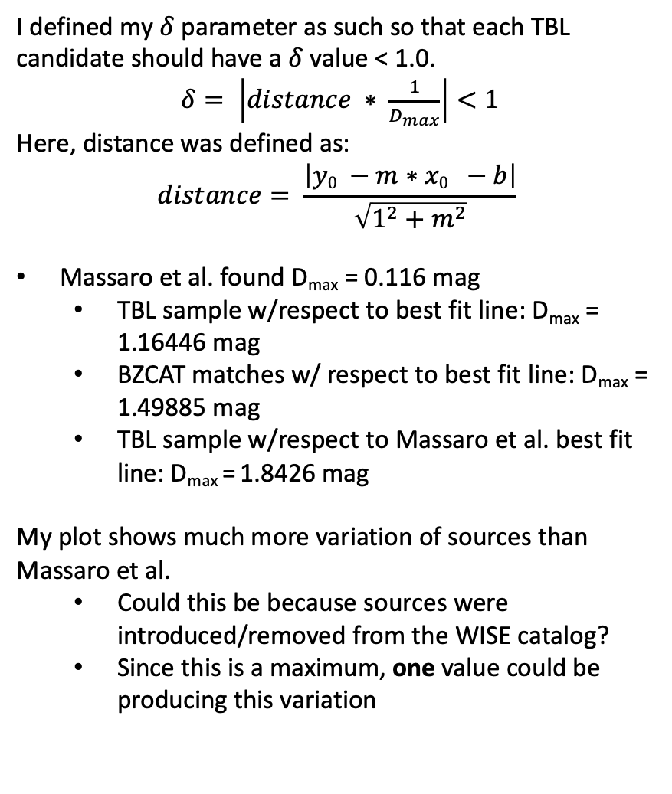
ROSAT & WISE
I defined my $δ$ parameter as such so that each TBL candidate should have a $δ$ value < 1.0.
$δ= \left|distance ∗ \frac{1}{D_{max}}\right|<1$
Here, distance was defined as:
$$distance= \frac{\left|y0 −m∗x0 −b\right|}{\sqrt{1^{2}+m^{2}}}$$
Massaro et al. found D_{max} = 0.116 mag
TBL sample w/respect to best fit line: D_{max} = 1.16446 mag
BZCAT matches w/ respect to best fit line: D_{max} = 1.49885 mag
TBL sample w/respect to Massaro et al. best fit line: D_{max} = 1.8426 mag
My plot shows much more variation of sources than Massaro et al.
Could this be because sources were introduced/removed from the WISE catalog?
Since this is a maximum, one value could be producing this variation
Total TBL sample (180 sources) distance from respective linear regression

Slide 7
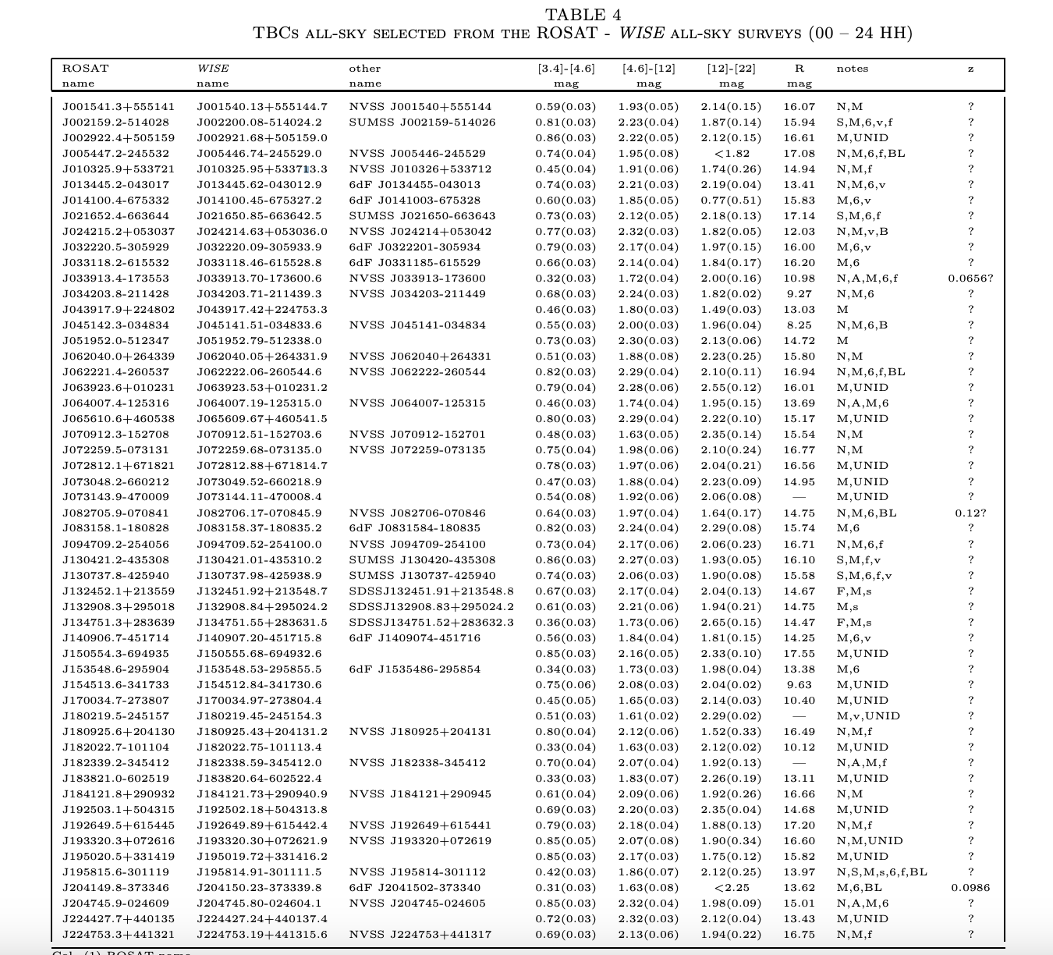
Checking my work against Massaro et al. (2013)
Table 4 contains 54 sources, there sources were selected from the 189 candidates
Massaro et al. (2013) removed 93 sources from the 189 that were associated with the ROMA-BZCAT catalog
The remaining 96 sources were analyzed using multifrequency analysis to select the most reliable high-frequency peaked BL Lacs that were candidates for TeV observations
Since I am not performing multifrequency analysis and excluding sources, I expect to find nearly all sources listed in Table 4 in my list of 180 TBL candidates
Table 4 from Massaro et al. 2013
Col. (1) ROSAT name. Col. (2) WISE name. Col. (3) Other name if present in literature and in the following order: NVSS, SDSS, AT20G, NED. Cols. (4,5,6) IR colors from WISE. Values in parentheses are 1σ uncertainties. Col. (7) Notes: N = NVSS, F = FIRST, S = SUMSS, A=AT20G, M = 2MASS, s = SDSS dr9, 6 = 6dFGS, x = XMM-Newton or Chandra, X = ROSAT; B=Swift-BAT; f=Fermi; BL = BL Lac (optical spectra available in Jones et al. 2009); v = variability in WISE (var flag > 5 in at least one band); UNID=ROSAT unidentified X-ray source. Col. (10) Redshift: ? = unknown, number? = uncertain.

Slide 8

So, what does this mean?
I’m working on matching my results to Massaro Table 4
If most of the Massaro results are found in my results, in means that the algorithm appears to be successful
If not, there’s a bug somewhere that I need to find ☹

